Slide 1
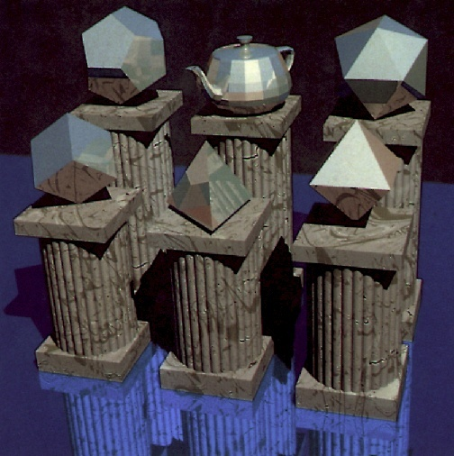
Ray Casting and Ray Tracing
‹#›
Notes:
‹#›

Slide 2
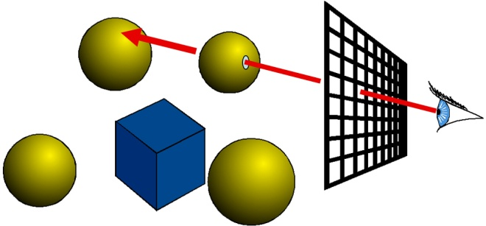
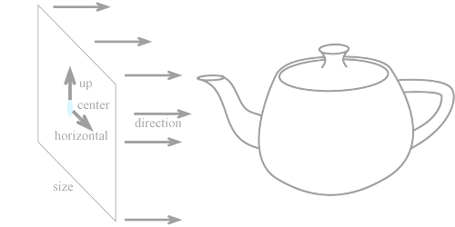
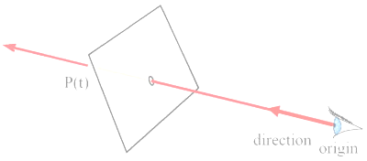
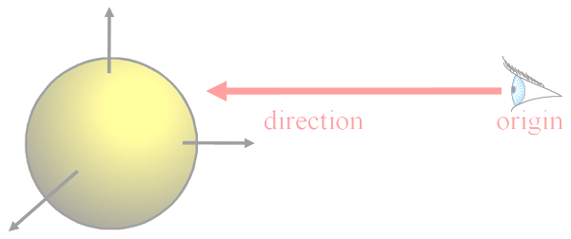
Topics
Ray Casting Basics
Camera and Ray Generation
Ray Object Intersection
Plane
Sphere
Triangle
General Quadric Surface
Recursive Ray Tracing
Mirror Reflection
Refraction
‹#›
Notes:
‹#›

Slide 3
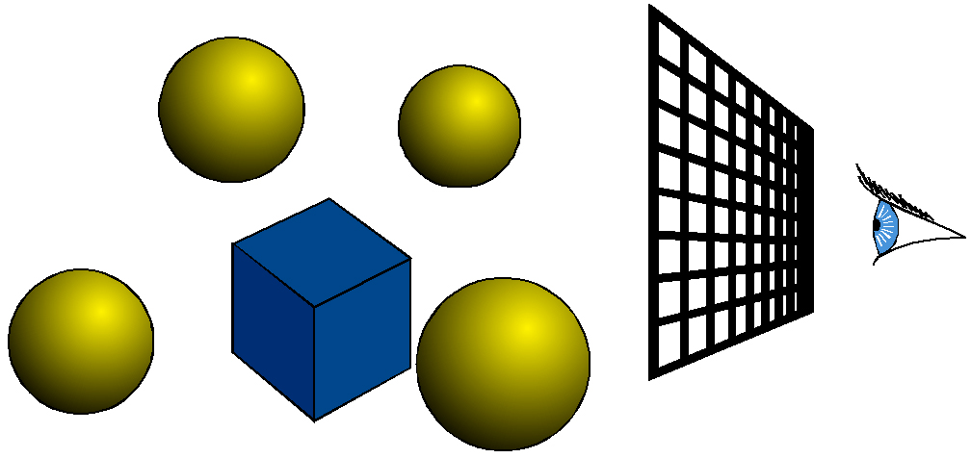
What is Ray Casting?
For every pixel
Construct a ray from the eye
For every object in the scene
Find intersection with the ray
Keep if closest
‹#›
Notes:
‹#›

Slide 4

Shading
For every pixel
Construct a ray from the eye
For every object in the scene
Find intersection with the ray
Keep if closest
Shade depending on light and normal vector
‹#›
Notes:
‹#›

Slide 5

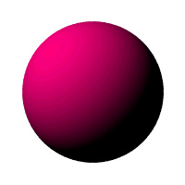
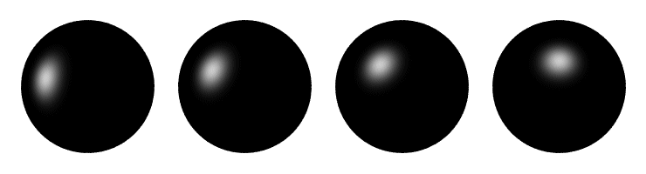
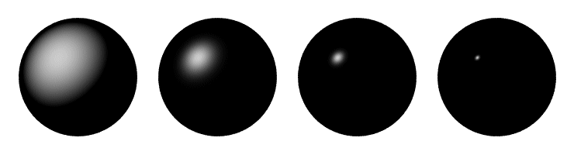
Shading - Recap
Surface/Scene Characteristics:
Surface normal
Direction to light
Viewpoint
Material Properties
Diffuse (matte)
Specular (shiny)
…
Lighting Model etc.
N
L
V
Diffuse sphere
Specular spheres
‹#›
Notes:
‹#›

Slide 6
What is Ray Tracing?
Secondary rays (shadows, reflection, refraction)
reflection
refraction
‹#›
Notes:
‹#›

Slide 7

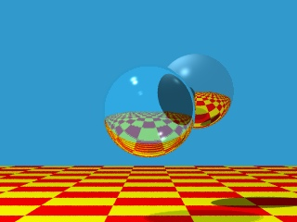
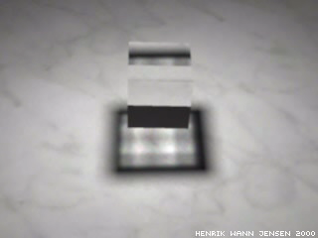
Ray Tracing Scenes
‹#›
Notes:
‹#›

Slide 8
Ray Casting - Basic Computations
For every pixel Construct a ray from the eye For every object in the scene
Find intersection with the ray
Keep if closest
Shade depending on light and normal vector
Finding the intersection and normal is the central part of ray casting
N
‹#›
Notes:
‹#›

Slide 9
Ray Casting vs. Ray Tracing
Ray Casting : Consider eye or camera rays only
Ray Tracing : Consider secondary rays too
Shadow rays
Reflected rays
Refracted rays etc.
reflection
refraction
‹#›
Notes:
‹#›

Slide 10
Ray Representation
Two vectors:
Origin
Direction (normalized is better)
Parametric line
P(t) = origin + t * direction
P(t)
direction
origin
‹#›
Notes:
‹#›

Slide 11


Topics
Ray Casting Basics
Camera and Ray Generation
Ray Object Intersection
Plane
Sphere
Triangle
General Quadric Surface
Recursive Ray Tracing
Mirror Reflection
Refraction
‹#›
Notes:
‹#›

Slide 12
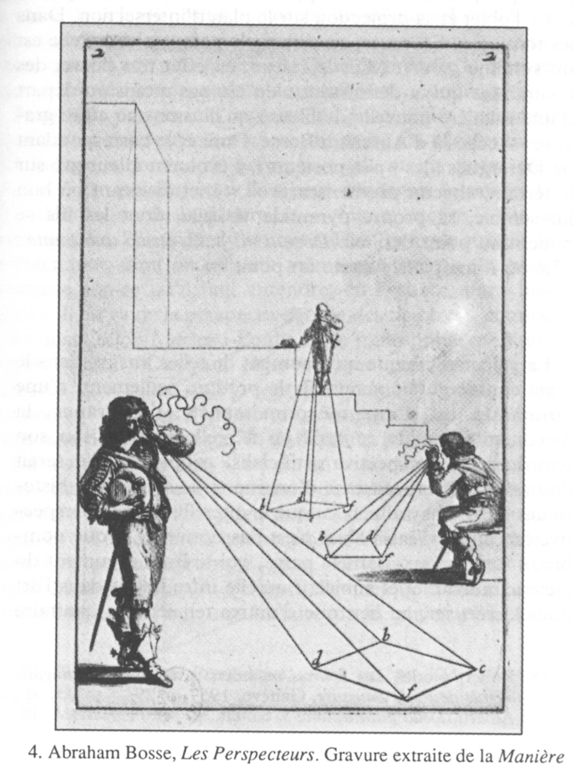
Cameras
For every pixel
Construct a ray from the eye
For every object in the scene
Find intersection with ray
Keep if closest
‹#›
Notes:
‹#›

Slide 13
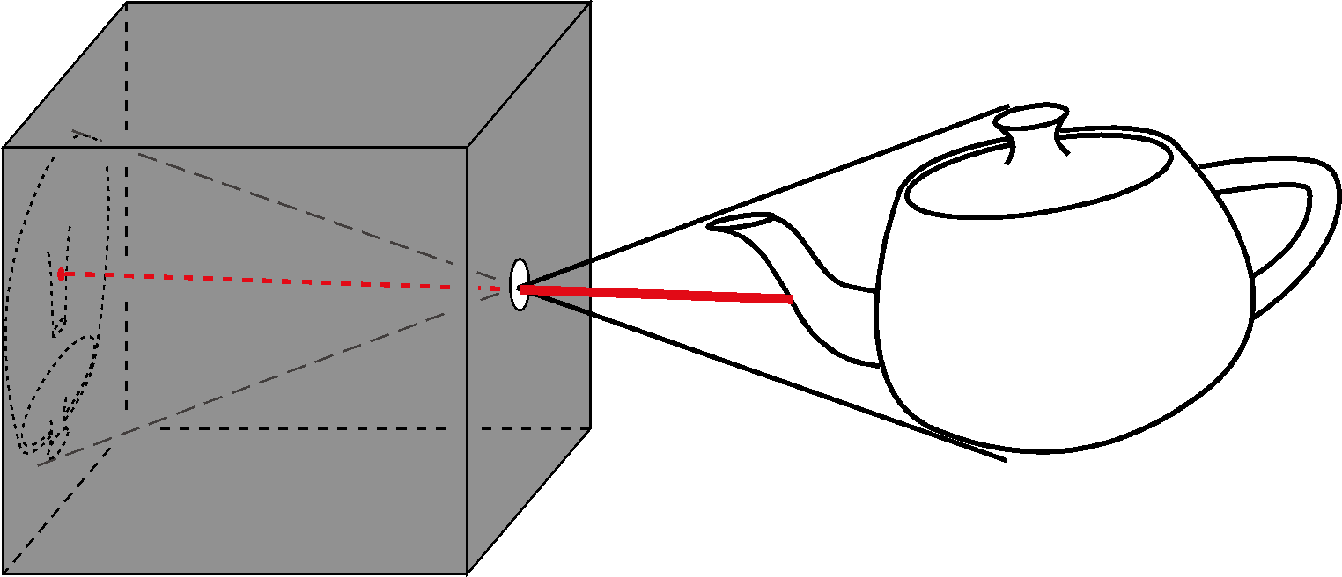
Pinhole Camera
Box with a tiny hole
Inverted image
Similar triangles
Perfect image if hole infinitely small
Pure geometric optics
No depth of field issue
‹#›
Notes:
‹#›

Slide 14
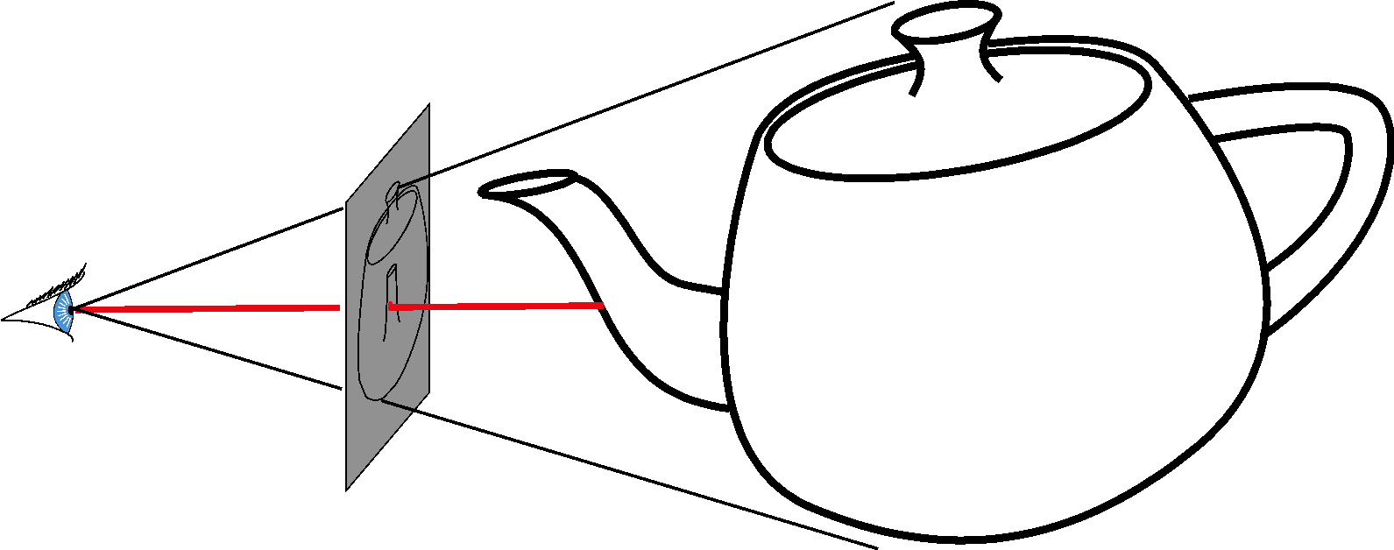
Simplified Pinhole Camera
Eye-image pyramid (frustum)
Note that the distance/size of image are arbitrary
‹#›
Notes:
‹#›

Slide 15
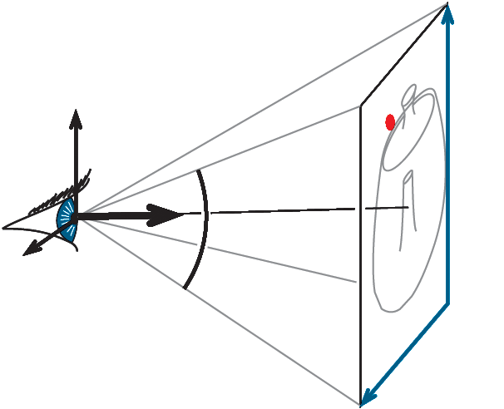
Camera Description
Eye point e (center)
Orthobasis u, v, w (horizontal, up, -direction)
Field of view angle
Image rectangle height, width
‹#›
Notes:
‹#›

Slide 16
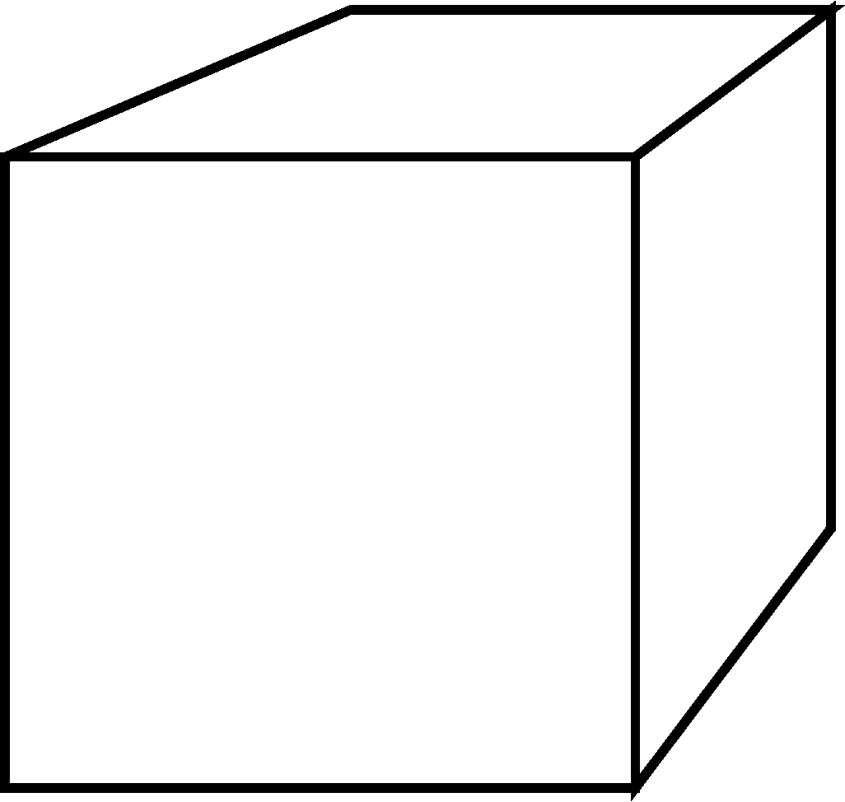
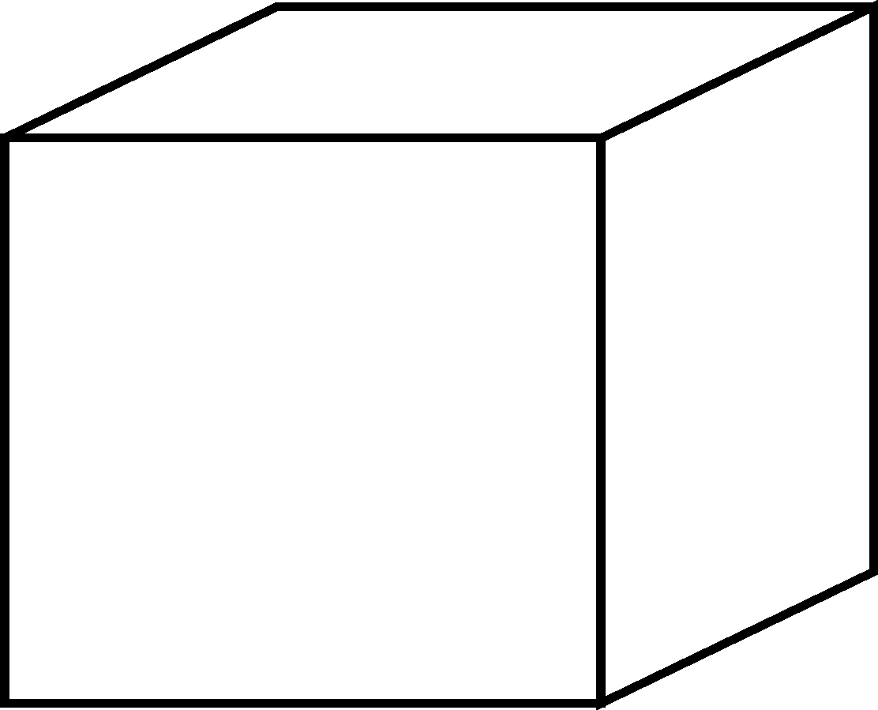
Perspective vs. Orthographic
perspective
orthographic
Parallel projection
No foreshortening
No vanishing point
‹#›
Notes:
‹#›

Slide 17
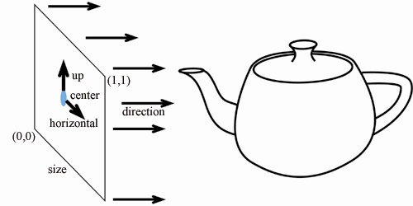
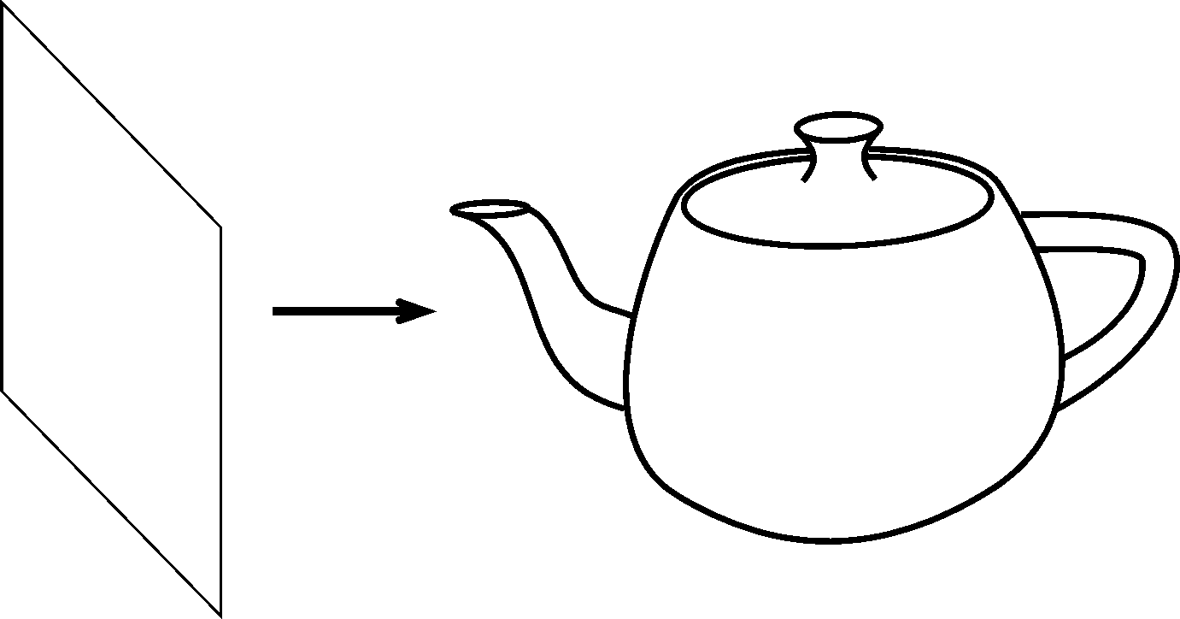
Orthographic Camera
Ray Generation?
Origin = center + (x-0.5)*size*horizontal + (y-0.5)*size*up ??
Direction is constant
‹#›
Notes:
‹#›

Slide 18
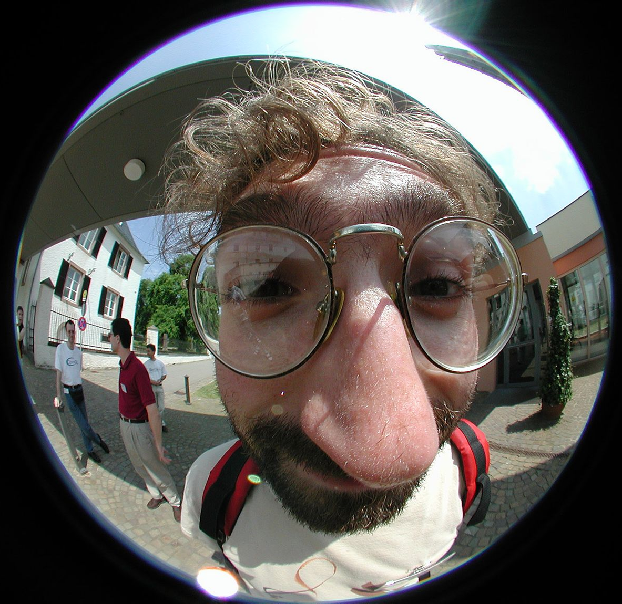
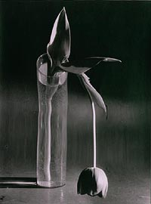
Other Weird Cameras
E.g. fish eye, omnimax, panorama
‹#›
Notes:
‹#›

Slide 19
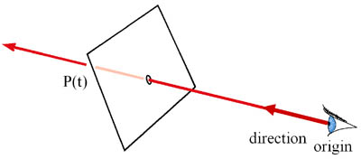
Topics
Ray Casting Basics
Camera and Ray Generation
Ray Object Intersection
Plane
Sphere
Triangle
General Quadric Surface
Recursive Ray Tracing
Mirror Reflection
Refraction
‹#›
Notes:
‹#›

Slide 20
Ray Casting – Finding Intersection
For every pixel Construct a ray from the eye For every object in the scene
Find intersection with the ray
Keep if closest
First we will study ray-plane intersection
‹#›
Notes:
‹#›

Slide 21
Recall: Ray Representation
Parametric line
P(t) = R_{o} + t * R_{d}
Explicit representation
P(t)
direction
R_{d}
origin
R_{o}
‹#›
Notes:
‹#›

Slide 22
3D Plane Representation?
Plane defined by
P_{o} = (x,y,z)
n = (A,B,C)
Implicit plane equation
H(P) = Ax+By+Cz+D = 0 = n·P + D = 0
Point-Plane distance?
If n is normalized, distance to plane, d = H(P)
d is the signed distance!
H(p) = d > 0
P
normal
P_{o}
H
P'
H(p) = d < 0
‹#›
Notes:
‹#›

Slide 23
Explicit vs. Implicit?
Ray equation is explicit P(t) = R_{o} + t * R_{d}
Parametric
Generates points
Hard to verify that a point is on the ray
Plane equation is implicit H(P) = n·P + D = 0
Solution of an equation
Does not generate points
Verifies that a point is on the plane
‹#›
Notes:
‹#›

Slide 24
Ray-Plane Intersection
Intersection means both are satisfied
So, insert explicit equation of ray into implicit equation of plane & solve for t
P(t) = R_{o} + t * R_{d}
H(P) = n·P + D = 0
n·(R_{o} + t * R_{d}) + D = 0
t = -(D + n·R_{o}) / n·R_{d}
P(t)
‹#›
Notes:
‹#›

Slide 25
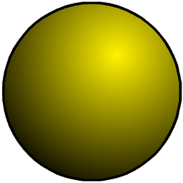
Additional Checks
Verify that intersection is closer than previous
Verify that it is not out of range (behind eye)
P(t) < t_{current}
P(t) > t_{min}
P(t)
‹#›
Notes:
‹#›

Slide 26
Normal
For shading
diffuse: dot product between light and normal
Normal is constant
normal
‹#›
Notes:
‹#›

Slide 27
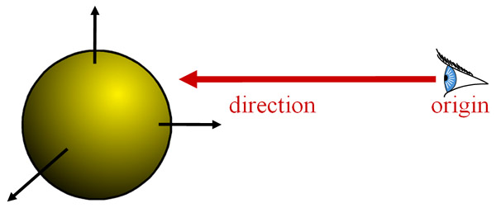
Topics
Ray Casting Basics
Camera and Ray Generation
Ray Object Intersection
Plane
Sphere
Triangle
General Quadric Surface
Recursive Ray Tracing
Mirror Reflection
Refraction
‹#›
Notes:
‹#›

Slide 28
Ray-Sphere Intersection
Sphere Representation : Implicit sphere equation
Assume centered at origin (easy to translate)
H(P) = P·P - r² = 0
R_{d}
R_{o}
‹#›
Notes:
‹#›

Slide 29
Ray-Sphere Intersection
Insert explicit equation of ray into implicit equation of sphere & solve for t
P(t) = R_{o} + t*R_{d} H(P) = P·P - r² = 0
(R_{o} + tR_{d}) · (R_{o} + tR_{d}) - r² = 0
R_{d}·R_{d}t² + 2R_{d}·R_{o}t + R_{o}·R_{o} - r² = 0
R_{d}
R_{o}
‹#›
Notes:
‹#›

Slide 30
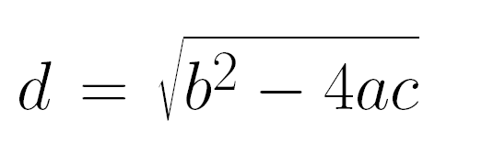
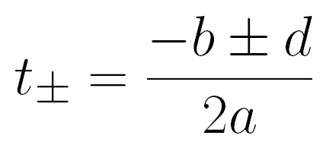
Ray-Sphere Intersection
Quadratic: at² + bt + c = 0
a = 1 (remember, ||R_{d}|| = 1)
b = 2R_{d}·R_{o}
c = R_{o}·R_{o} – r²
with discriminant
and solutions
‹#›
Notes:
‹#›

Slide 31
Ray-Sphere Intersection
3 cases, depending on the sign of b² – 4ac
What do these cases correspond to?
Which root (t+ or t-) should you choose?
Closest positive! (usually t-)
‹#›
Notes:
‹#›

Slide 32
Ray-Sphere Intersection
It's so easy that all ray-tracing images have spheres!
‹#›
Notes:
‹#›

Slide 33
Geometric Ray-Sphere Intersection
Shortcut / easy reject
What geometric information is important?
Ray origin inside/outside sphere?
Closest point to ray from sphere origin?
Ray direction: pointing away from sphere?
‹#›
Notes:
‹#›

Slide 34
Geometric Ray-Sphere Intersection
Is ray origin inside/outside/on sphere?
(R_{o}·R_{o} < r² / R_{o}·R_{o} > r² / R_{o}·R_{o} = r²)
If origin on sphere, be careful about degeneracies…
O
r
R_{d}
R_{o}
‹#›
Notes:
‹#›

Slide 35
Geometric Ray-Sphere Intersection
Is ray origin inside/outside/on sphere?
Find closest point to sphere center, t_{P} = - R_{o} · R_{d}
If origin outside & t_{P} < 0 → no hit
O
r
R_{d}
R_{o}
t_{P}
‹#›
Notes:
‹#›

Slide 36
Geometric Ray-Sphere Intersection
Is ray origin inside/outside/on sphere?
Find closest point to sphere center, t_{P} = - R_{o} · R_{d.}
Find squared distance, d² = R_{o}·R_{o} - t_{P}²
If d² > r² → no hit
O
d
r
R_{d}
R_{o}
t_{P}
‹#›
Notes:
‹#›

Slide 37
Geometric Ray-Sphere Intersection
Is ray origin inside/outside/on sphere?
Find closest point to sphere center, t_{P} = - R_{o} · R_{d.}
Find squared distance: d² = R_{o}·R_{o} - t_{P}²
Find distance (t’) from closest point (t_{P}) to correct intersection: t’² = r² - d²
If origin outside sphere → t = t_{P} - t’
If origin inside sphere → t = t_{P} + t’
O
d
r
R_{d}
R_{o}
t_{P}
t’
t
‹#›
Notes:
‹#›

Slide 38
Geometric vs. Algebraic
Algebraic is simple & generic
Geometric is more efficient
Timely tests
In particular for rays outside and pointing away
‹#›
Notes:
‹#›

Slide 39
Sphere Normal
Simply Q/||Q||
Q = P(t), intersection point
(for spheres centered at origin)
O
R_{d}
R_{o}
Q
normal
‹#›
Notes:
‹#›

Slide 40
Topics
Ray Casting Basics
Camera and Ray Generation
Ray Object Intersection
Plane
Sphere
Triangle
General Quadric Surface
Recursive Ray Tracing
Mirror Reflection
Refraction
‹#›
Notes:
‹#›

Slide 41
Ray-Triangle Intersection
First, intersect ray with plane
Then, check if point is inside triangle
P
V
P₀
Notes:
‹#›

Slide 42
Ray-Triangle Intersection
Check if point is inside triangle parametrically
T₃
Compute α, β:
P = α (T₂-T₁) + β (T₃-T₁)
Check if point inside triangle.
0 ≤ α ≤ 1 and 0 ≤ β ≤ 1
α + β ≤ 1
P
β
T₁
α
T₂
V
P₀
Notes:
‹#›

Slide 43
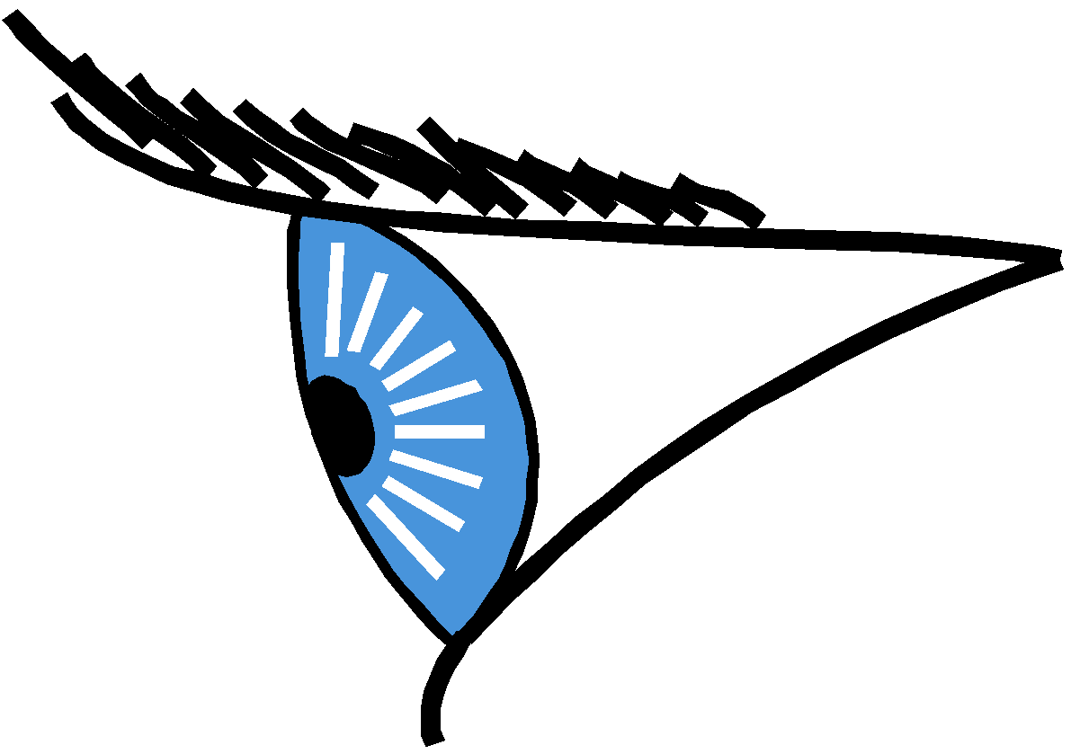
Ray-Triangle Intersection
Use general ray-polygon
Or try to be smarter
Use barycentric coordinates (XM)
c
P
R_{d}
R_{o}
a
b
‹#›
Notes:
‹#›

Slide 44
Barycentric Definition of a Plane
[Möbius, 1827]
P(α, β, γ) = αa + βb + γc with α + β + γ =1
Is it explicit or implicit?
c
P is the barycenter: the single point upon which the plane would balance if weights of size α, β, & γ are placed on points a, b, & c.
P
a
b
‹#›
Notes:
‹#›

Slide 45
Barycentric Definition of a Triangle
P(α, β, γ) = αa + βb + γc with α + β + γ =1
AND 0 < α < 1 & 0 < β < 1 & 0 < γ < 1
c
P
a
b
‹#›
Notes:
‹#›

Slide 46
How Do We Compute α, β, γ ?
Ratio of opposite sub-triangle area to total area
α = A_{a}/A β = A_{b}/A γ = A_{c}/A
Use signed areas for points outside the triangle
c
A_{a}
A
P
a
b
‹#›
Notes:
‹#›

Slide 47
Intuition Behind Area Formula
P is barycenter of a and Q
A_{a} is the interpolation coefficient on aQ
All points on lines parallel to bc have the same α (All such triangles have same height/area)
c
A_{a}
A
P
Q
a
b
‹#›
Notes:
‹#›

Slide 48
Simplify
Since α + β + γ =1, we can write α =1− β − γ
P(α, β, γ) = αa + βb + γc
P(β, γ) = (1−β−γ)a + βb + γc
= a + β(b-a) + γ(c-a)
rewrite
c
Non-orthogonal coordinate system of the plane
P
a
b
‹#›
Notes:
‹#›

Slide 49
Intersection with Barycentric Triangle
Set ray equation equal to barycentric equation
P(t) = P(β, γ)
R_{o} + t * R_{d} = a + β(b-a) + γ(c-a)
Intersection if β + γ < 1 & β > 0 & γ > 0 and t > 0 (or t_{min})
c
P
R_{d}
R_{o}
a
b
‹#›
Notes:
‹#›

Slide 50
Intersection with Barycentric Triangle
R_{o} + t * R_{d} = a + β(b-a) + γ(c-a)
R_{ox} + tR_{dx} = a_{x} + β(b_{x}-a_{x}) + γ(c_{x}-a_{x})
R_{oy} + tR_{dy} = a_{y} + β(b_{y}-a_{y}) + γ(c_{y}-a_{y})
R_{oz} + tR_{dz} = a_{z} + β(b_{z}-a_{z}) + γ(c_{z}-a_{z})
Regroup & write in matrix form:
3 equations, 3 unknowns
⎡
a
−
b
a
−
c
R
⎤
⎡
β
⎤
⎡
a
−
R
⎤
x
x
x
x
dx
x
ox
⎢
−
−
⎥
⎢
⎥
⎢
−
⎥
a
b
a
c
R
γ
=
a
R
⎢
y
y
y
y
dy
⎥
⎢
⎥
⎢
y
oy
⎥
⎢
a
−
b
a
−
c
R
⎥
⎢
t
⎥
⎢
a
−
R
⎥
⎣
z
z
z
z
dz
⎦
⎣
⎦
⎣
z
oz
⎦
‹#›
Notes:
‹#›

Slide 51
Cramer’s Rule
Used to solve for one variable at a time in system of equations
a
−
R
a
−
c
R
a
−
b
a
−
R
R
x
ox
x
x
dx
x
x
x
ox
dx
a
−
R
a
−
c
R
a
−
b
a
−
R
R
y
oy
y
y
dy
y
y
y
oy
dy
a
−
R
a
−
c
R
a
−
b
a
−
R
R
β
=
z
oz
z
z
dz
γ
=
z
z
z
oz
dz
A
A
a
−
b
a
−
c
a
−
R
| | denotes the determinant
Can be copied mechanically into code
x
x
x
x
x
ox
a
−
b
a
−
c
a
−
R
y
y
y
y
y
oy
a
−
b
a
−
c
a
−
R
t
=
z
z
z
z
z
oz
A
‹#›
Notes:
‹#›

Slide 52

Advantages of Barycentric Intersection
Efficient
Stores no plane equation
Get the barycentric coordinates for free
Useful for interpolation, texture mapping
c
P
R_{d}
R_{o}
a
b
‹#›
Notes:
‹#›

Slide 53
Topics
Ray Casting Basics
Camera and Ray Generation
Ray Object Intersection
Plane
Sphere
Triangle
General Quadric Surface
Recursive Ray Tracing
Mirror Reflection
Refraction
‹#›
Notes:
‹#›

Slide 54
General Quadric Surfaces
Some Common Quadric Surfaces
Ellipsoid (x²/a²+ y²/b² + z²/c² + 1= 0)
Cone (x²/a²- y²/b² + z²/c² = 0)
Cylinder
Hyperboloid
Paraboloid – Eliptic, Hyperbolic etc.
* Check out the following links for the figures & equations: https://tutorial.math.lamar.edu/Classes/CalcIII/QuadricSurfaces.aspx https://mrl.cs.nyu.edu/~dzorin/rend05/lecture2.pdf (page12-14)
‹#›
Notes:
‹#›

Slide 55
Ray - Quadric Surface Intersection
General Quadric Surface Equation
Ax² + By² + Cz² + Dxy + Eyz + Fxz + Gx + Hy +Iz + J = 0 … …(1)
Ray Equation : P(t) = R_{o} + t * R_{d}
So, P_{x} = R_{0x} + t*R_{dx}, Similar for P_{y}, P_{z}
Put P_{x}, P_{y}, P_{z} as x, y, z in eq.(1) and solve for t
Accept the smaller non –ve real value of t
General Quadric Surface Normal
Use partial derivatives!
‹#›
Notes:
‹#›

Slide 56
Topics
Ray Casting Basics
Camera and Ray Generation
Ray Object Intersection
Plane
Sphere
Triangle
General Quadric Surface
Recursive Ray Tracing
Mirror Reflection
Refraction
‹#›
Notes:
‹#›

Slide 57
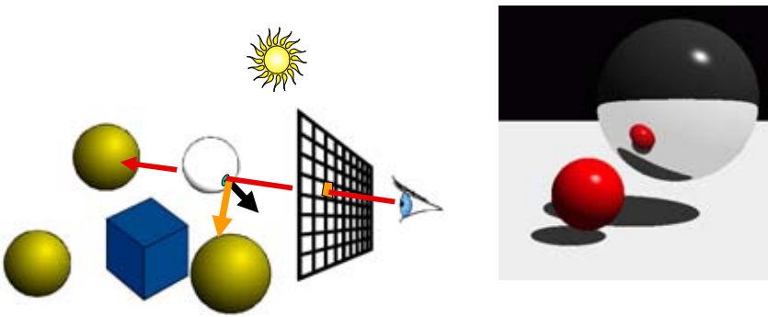
Mirror Reflection
Compute reflected ray – according to law of reflection on an ideal mirror
Include contribution of this reflection in color
‹#›
Notes:
‹#›

Slide 58
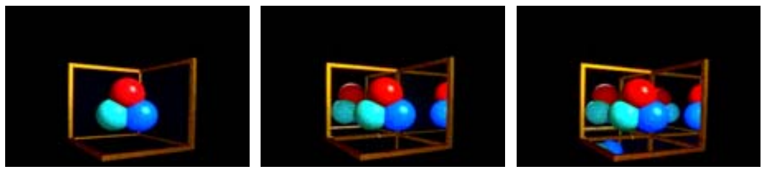
Mirror Reflection
Depth of recursion in reflection
Depth = 0 Depth = 1 Depth = 2
‹#›
Notes:
‹#›

Slide 59
Topics
Ray Casting Basics
Camera and Ray Generation
Ray Object Intersection
Plane
Sphere
Triangle
General Quadric Surface
Recursive Ray Tracing
Mirror Reflection
Refraction
‹#›
Notes:
‹#›

Slide 60
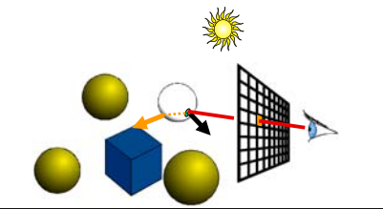
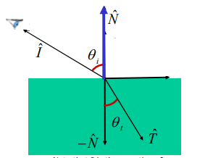

Refraction
Compute refracted ray – according to law of refraction
‹#›
Notes:
‹#›

Slide 61
Base Case of Recursive Ray Tracing?
A fixed no. of times (controlling recursion depth)
When ray contribution becomes insignificant
Both
‹#›
Notes:
‹#›

Slide 62
Precision Issues
What happens when
Origin is on an object?
Self shadowing!!
Self reflection!!
Grazing rays?
Problem with floating-point approximation
‹#›
Notes:
‹#›

Slide 63
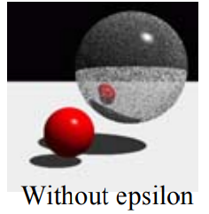
The Evil ε
In ray tracing, do NOT report intersection for rays starting at the surface (no false positive)
Because secondary rays requires epsilons
reflection
shadow
refraction
‹#›
Notes:
‹#›

Slide 64
The Evil ε : Challenges
Edges in triangle meshes
Must report intersection (otherwise not watertight)
No false negative
‹#›
Notes:
‹#›

Slide 65
References
Textbook : Fundamentals of Computer Graphics (3rd edition) by Peter Shirley, Steve Marschner et. al – Chapter 4 (Extra – Chapter 13) [May be insufficient]
Computer Graphics – MIT OpenCourseWare : Lecture 11, 12, 13 (Extra resource – Lecture 14) https://ocw.mit.edu/courses/electrical-engineering-and-computer-science/6-837-computer-graphics-fall-2012/lecture-notes/
https://tutorial.math.lamar.edu/Classes/CalcIII/QuadricSurfaces.aspx
https://mrl.cs.nyu.edu/~dzorin/rend05/lecture2.pdf
http://www.cs.tau.ac.il/~dcor/Graphics/adv-slides/ray-tracing06.pdf
Shirley P., M. Ashikhmin and S. Marschner, Fundamentals of Computer Graphics
Shirley P. and R.K. Morley, Realistic Ray Tracing
Jensen H.W., Realistic Image Synthesis Using Photon Mapping
‹#›
Notes:
‹#›

Slide 66
Thank you ☺

